Slide 1
NO ONE STANDS ALONE
Lessons From The Master

Slide 2


Slide 3


Slide 4



Slide 5


Slide 6
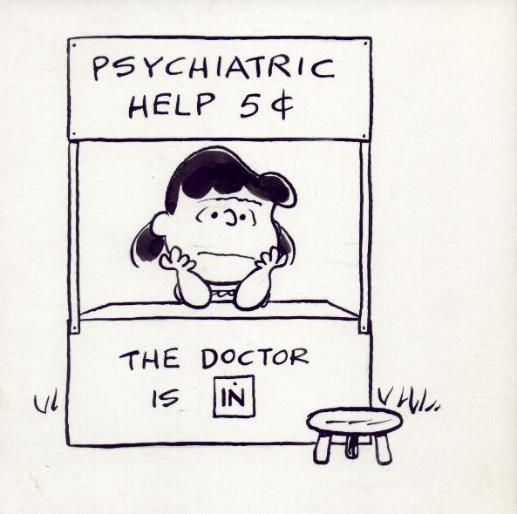

Slide 7


Slide 8


Slide 9
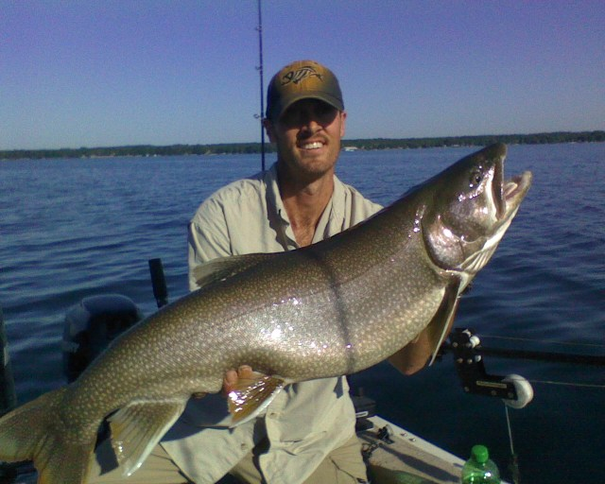

Slide 10


Slide 11
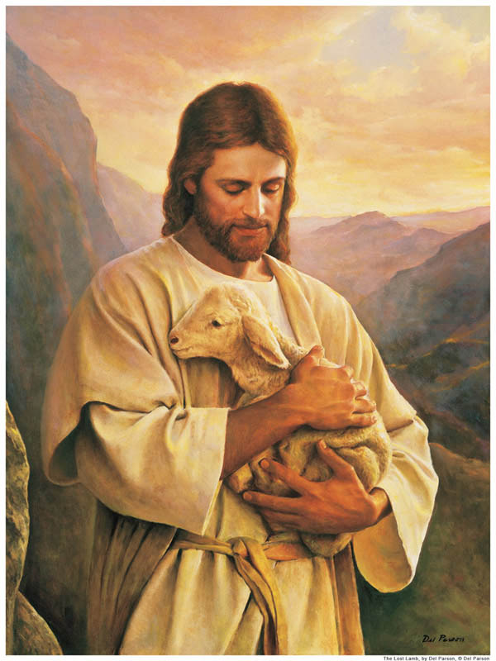

Slide 12
NO ONE STANDS ALONE
Lessons From The Master
They devoted themselves to fellowship. Acts 2:42

Slide 13
NO ONE STANDS ALONE
Lessons From The Master
Acts 2:42 They devoted themselves to the apostles’ teaching and to fellowship, to the breaking of bread and to prayer.

Slide 14
NO ONE STANDS ALONE
Lessons From The Master
They devoted themselves to fellowship. Acts 2:42
They ate together with glad and sincere hearts. Acts 2:46-47

Slide 15
NO ONE STANDS ALONE
Lessons From The Master
Acts 2:46-47 Every day they continued to meet together in the temple courts. They broke bread in their homes and ate together with glad and sincere hearts, praising God and enjoying the favor of all the people.

Slide 16
NO ONE STANDS ALONE
Lessons From The Master
They devoted themselves to fellowship. Acts 2:42
They ate together with glad and sincere hearts. Acts 2:46-47
They spoke the truth in love. Eph. 4:15

Slide 17
NO ONE STANDS ALONE
Lessons From The Master
Eph 4:15 … speaking the truth in love, we will grow to become in every respect the mature body of him who is the head, that is, Christ.

Slide 18
NO ONE STANDS ALONE
Lessons From The Master
They devoted themselves to fellowship. Acts 2:42
They ate together with glad and sincere hearts. Acts 2:46-47
They spoke the truth in love. Eph. 4:15
Their conflict led to reconciliation and growth. I Peter 3:8-9

Slide 19
NO ONE STANDS ALONE
Lessons From The Master
1 Peter 3:8-9 Finally, all of you, be like-minded, be sympathetic, love one another, be compassionate and humble. Do not repay evil with evil or insult with insult. On the contrary, repay evil with blessing, because to this you were called so that you may inherit a blessing.

Slide 20
NO ONE STANDS ALONE
Lessons From The Master
They devoted themselves to fellowship. Acts 2:42
They ate together with glad and sincere hearts. Acts 2:46-47
They spoke the truth in love. Eph. 4:15
Their conflict led to reconciliation and growth. I Peter 3:8-9
Their mission went beyond themselves. Matthew 18:20

Slide 21
NO ONE STANDS ALONE
Lessons From The Master
Matthew 18:20 For where two or three gather in my name, there am I with them.”

